Slide 1
Architectural Patterns -II
Emre Kaplan, Ph.D.

Slide 2
Architectural Design Patterns
Broker
Transaction Processing
Pipe and Filter
Service oriented Architecture (SoA)
Message Oriented Middleware (MoM)
Three-Tier Architecture
Model-View-Controller (MVC)
Microservices
Data Transfer Object
Command Query Responsibility Segregation (CQRS)
Unit of Work

Slide 3
Data Transfer Object
Intent
Pass data with multiple attributes in one shot from client to server, to avoid multiple calls to remote server.
Context
You are designing a distributed application, and to satisfy a single client request, you find yourself making multiple calls to a remote interface, which increases the response time beyond acceptable levels.
Problem
How do you preserve the simple semantics of a procedure call interface without being subject to the latency issues inherent in remote communication?

Slide 4
Data Transfer Object
Solution
Create a data transfer object (DTO) that holds all data that is required for the remote call.
Modify the remote method signature to accept the DTO as the single parameter and to return a single DTO parameter to the client.
After the calling application receives the DTO and stores it as a local object, the application can make a series of individual procedure calls to the DTO without incurring the overhead of remote calls.

Slide 5
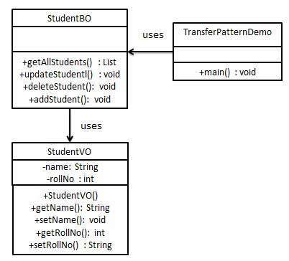
Data Transfer Object
Following are the entities of this type of design pattern.
Business Object (StudentBO) - Business Service fills the Transfer Object with data.
Transfer Object (StudentVO) - Simple POJO having methods to set/get attributes only.
Client (TransferPatternDemo) - Client either requests or sends the Transfer Object to Business Object.

Slide 6
Command Query Responsibility Segregation (CQRS)
Intent
Separate the query side from the command side.
CQRS is simply the creation of two objects where there was previously only one.
The separation occurs based upon whether the methods are a command or a query
a command is any method that mutates state and a query is any method that returns a value.
https://martinfowler.com/bliki/CQRS.html

Slide 7
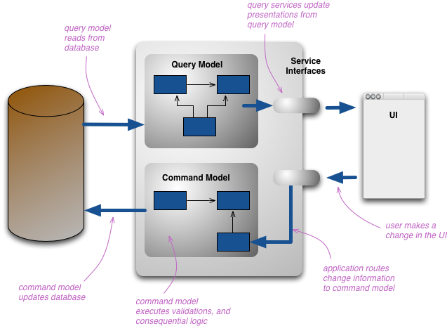
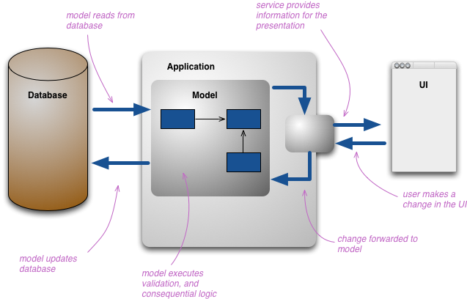
CQRS

Slide 8
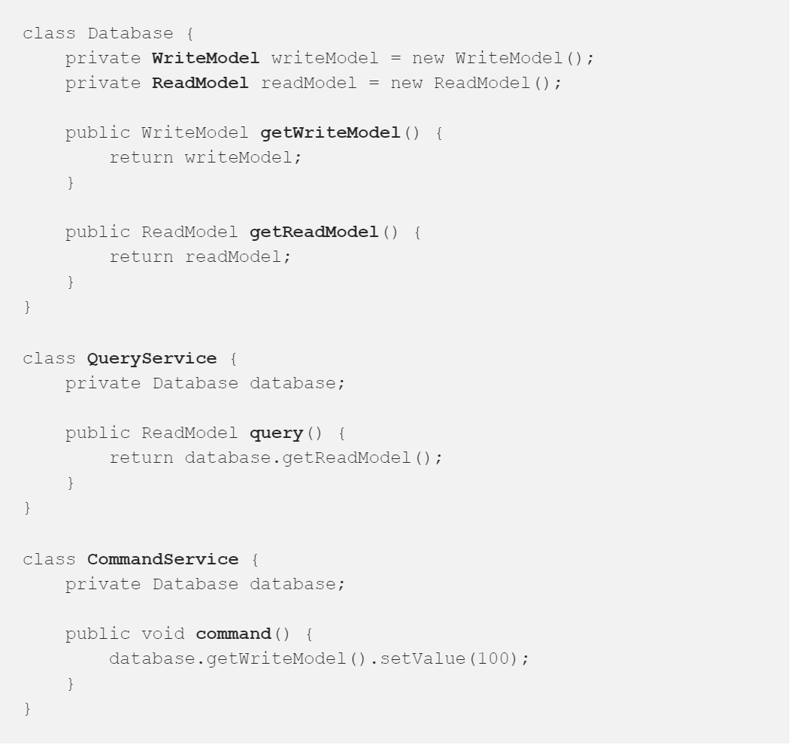
CQRS
How Read Model will know that something changed in Write Model?
Database class, is only a mock of a real database. We delegate model’s dependency to a database. In the world of relational databases WriteModel would be mapped to TABLE and ReadModel can be mapped to VIEW.
https://medium.com/applantic/use-cqrs-part-ii-f2d2b112e3a9

Slide 9
Applicability
Use the CQRS pattern when you want to:
scale the queries and commands independently.
use different data models for queries and commands.
use different strategies for the sides: reads and writes
Suitable to apply CQRS pattern to the object that represents the service boundary of the application.
Notes:
Useful when dealing with complex domains.
use architectures like event sourcing or task based UI.

Slide 10
Applicability
Using CQRS on a domain that doesn't match it will add complexity, thus reducing productivity and increasing risk.
Usually there's enough overlap between the command and query sides that sharing a model is easier.
Handling high performance applications.
CQRS allows you to separate the load from reads and writes allowing you to scale each independently.
If your application sees a big disparity between reads and writes this is very handy.
You can apply different optimization strategies to the two sides.
An example of this is using different database access techniques for read and update.

Slide 11
Consequences
Despite these benefits, you should be very cautious about using CQRS.
Many information systems fit well with the notion of an information base that is updated in the same way that it's read, adding CQRS to such a system can add significant complexity.

Slide 12
Unit of Work
Intent
When a business transaction is completed, all the these updates are sent as one big unit of work to be persisted in a database in one go so as to minimize database trips.
Maintains a list of objects affected by a business transaction and coordinates the writing out of changes and the resolution of concurrency problems.
Every time you create, change, or delete an object you tell the Unit of Work.
The key thing about Unit of Work is that, when it comes time to commit, the Unit of Work decides what to do. It opens a transaction, does any concurrency checking and writes changes out to the database.

Slide 13
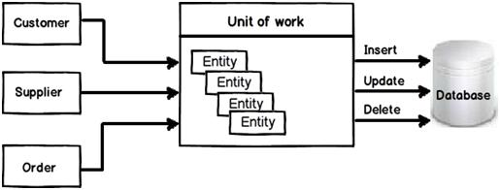
Unit of Work

Slide 14
Unit of Work
You can change the database with each change to your object model.
It leads to lots of very small database calls, which ends up being very slow.
It requires you to have a transaction open for the whole interaction, which is impractical if you have a business transaction that spans multiple requests.
It leads to inconsistent reads (what if the objects are read are also tracked?).
A Unit of Work keeps track of everything you do during a business transaction that can affect the database.
When you're done, it figures out everything that needs to be done to alter the database as a result of your work.
Notes:
The situation is even worse if you need to keep track of the objects you've read so you can avoid inconsistent reads.

Slide 15
Unit of Work
The fundamental problem that Unit of Work deals with is keeping track of the various objects you’ve manipulated so that you know which ones you need to consider to synchronize your in-memory data with the database.
To avoid multiple database calls, you can leave all your updates to the end.
To do this you need to keep track of all the objects that have changed.

Slide 16
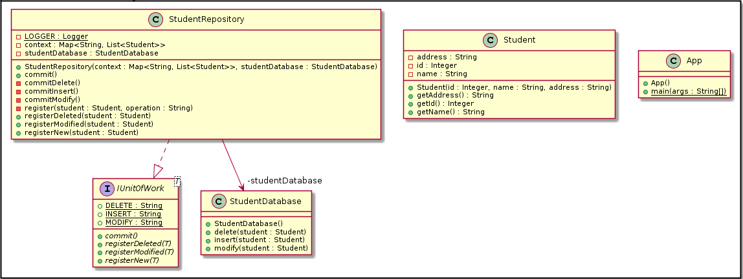
Unit of Work
https://java-design-patterns.com/patterns/unit-of-work/

Slide 17
Applicability
Use the Unit Of Work pattern when you want to:
optimize the time taken for database transactions.
reduce number of database calls.
send changes to database as a unit of work which ensures atomicity of the transaction.

Slide 18
Applicability
Use the Data Transfer Object pattern when:
The client is asking for multiple information and the information is related.
you want to boost the performance to get resources.
You want reduced number of remote calls.

